Slide 1
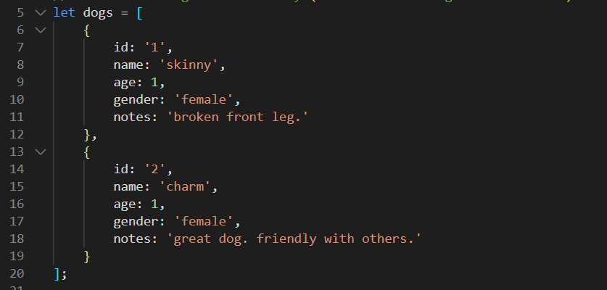
Remember, our dogs object is a JavaScript Array of dogs

Slide 2
JavaScript has a built in object called Array
The Array object gives us a lot of methods and properties natively. In other words, we have access to these automatically
One of these methods is called find()
Array.find() lets us find and return the first occurrence of an element in an array, under a defined testing function

Slide 3

Using find() is super duper easy!
The only required parameter is a testing function, and it can be as simple or complex as you need
Array.find(testingFunction);
Bottom line: when you want a needle from a haystack, use find()

